Slide 1
SIP Integration

Slide 2
Software Integration Package (SIP)
MICROSAR.SIP is a standard delivery item, and it focuses on the broadest possible range of use for your stack. It optimizes the usability of our delivery to you, even when constraints are altered slightly. Our portfolio in brief:
> Check the OEM-specific aspects of the BSW, including SWCs and the associated tool chain (e.g. support of OEM data formats for communication and diagnostics) and assure conformance to OEM specifications.
> Check the project-specific combination of BSW components and features for a defined ECU use case.
> Check the package under abstract constraints: both the configuration and the initial database can still be changed over the course of your project. This even occurs very frequently in practice. Our goal is to implement your MICROSAR package so that it covers a wide range, i.e. to enable implementation of as many additional variants to the initial configuration and database as possible.
> Check the package under project-specific constraints: (microcontroller derivative, compiler/linker version and compiler/linker options). Here we look at the specific constraints of your project as closely as possible, so that the product can be integrated smoothly for you. For example, we select an evaluation board with a suitable device from the microcontroller product line you have selected, and test the software package on it. The goal here is to ensure that our delivery to you can be run on as many devices as possible from the preselected processor line.
> Offer management specific to delivery of the ordered MICROSAR modules in the context of our configuration management. The option for after-sale redeliveries is made sure for a time period of 10 years.
> Actively issue reporting at regular intervals.

Slide 3
Application Area of the SIP
MICROSAR.SIP is a fixed component of every MICROSAR delivery, regardless of whether it is a prototype, beta, update or production delivery. The performance range is adapted to the purpose of the SIP and the context in which it will be used.
Via a questionnaire, we catalog your requirements in as much detail as possible in advance of delivery. Afterwards we custom-build your Software Integration Package as individually as possible on this basis.
SIP Maintenance gives you active issue tracking beginning with the initial product delivery; it informs you of known errors and potential work-arounds. In addition, SIP Maintenance includes one SIP update delivery per calendar year, and Extended Maintenance even gives you two SIP update deliveries per year.
By offering the update SIP, we actively help you to introduce a new SIP and/or a new database into your project and to test it.

Slide 4
Extensions for the SIP
The Extension "Start Application" is an included service to the MICROSAR SIP if it is technically possible for the customer project. The SIP delivery in this case includes a Start Application based on the ECU specific input data for communication (e.g. ECU Extract) and diagnostics (e.g. ECUC). This Start Application demonstrates basic SIP functionality based on the ordered modules. Some examples are listed below:
> Communication: The Start Application included SWCs demonstrate the reception and transmission of one signal on runnable level. The BSW is configured in a way that the system gets initialized and communicates on all communication busses defined in the input data.
> Diagnostics: The Start Application included SWCs will be extended by a sample implementation of an RDBI/WDBI service on runnable level. Moreover it offers the possibility to trigger a DTC.
> Memory: The Start Application included SWCs will be extended by a sample implementation to store data to an NV-Block.
Prerequisite for the execution of these tasks is that the required MICROSAR modules are part of the delivery.

Slide 5
Automotive OEM-independent and dependent extensions
Automotive OEM-independent extensions give you an easy way to start by having our integration team implement key tasks even before your MICROSAR Stack is delivered to you:
> Extension "Customer Hardware":
> Puts the ECU into an operationally ready state including CPU clock, PLL and internal watchdog
> Configures the network transceiver
> Executes the general delivery test at Vector on real customer hardware
Automotive OEM-dependent extensions require close interaction between you and our team; they handle extended ECU dependencies such as:
> OEM application: incorporates modules specially developed by the automotive OEM that supplement the AUTOSAR basic software
> OEM test: executes special tests that incorporate OEM modules and generates all test reports

Slide 6
Extended Integration Package (EIP)
Building upon the MICROSAR.SIP, in conjunction with extended SIP extensions (see above), MICROSAR.EIP assists in follow-up activities after an initial delivery. It offers crucial support in achieving a quick and comprehensive startup. The goal here is to pass the first bench test at the OEM.
Vector employees handle preparations that are normally conducted on-site at the customer. We perform this service at a fixed price and in the framework of task planning that is detailed in an agreement with you. We can:
> Place a start application in your ECU with a specification-conformant configuration and using the databases (communication and diagnostics) that are relevant to the project
> Perform other project management jobs such as coordination via regular consultation meetings and project reporting
> Create release planning tailored to your needs
> Perform on-site startup together with you at the end of the EIP service package
> Execute test cases related to the BSW that are required by the OEM
The results of these prepared activities are then also part of the delivery:
> Your basic software package including configured start application
> Release notes
> Write-up of related test reports

Slide 7
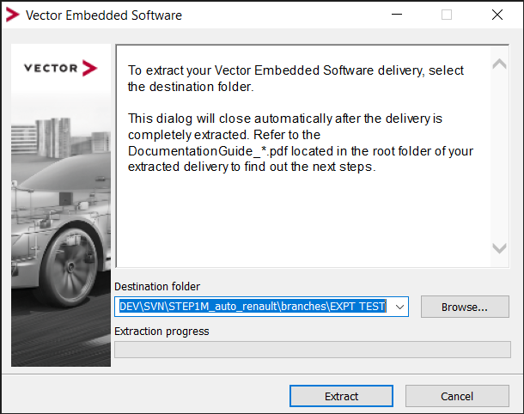
Steps for SIP Integration
SIP will be provided by vector in an executable file format and a password will be provided for extracting the SIP files.
Extract the SIP to the right path.

Slide 8
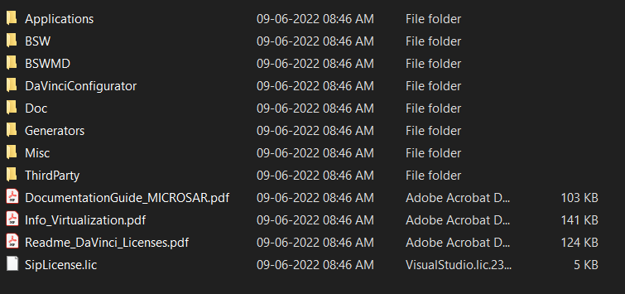
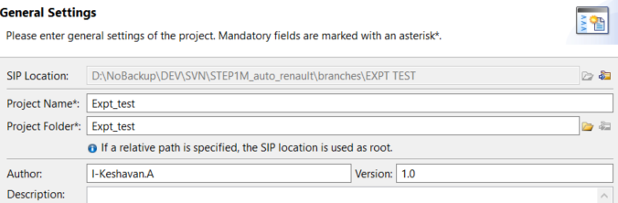
Steps for SIP Integration (Contd.)
The extracted folder will look like this :-
Make sure to have installed the right versions Davinci Developer and Configurator amd CANdela
First we need to setup the Project :-
The DaVinci Configurator Classic is located in your SIP Folder:
<SIPFolder>\DaVinciConfigurator\Core\DaVinciCFG.exe
Open File|New ECU Project....
A set of four configuration windows will open;
General Settings,Project Folder Structure, Target, DaVinci Developer Classic and [TA Tool Suite].
2. Enter the necessary information for each window and click [Next>] to get to the next window.

Slide 9
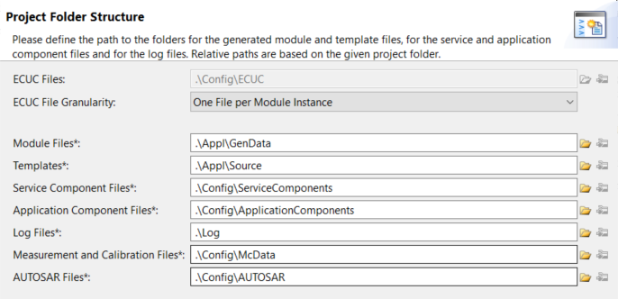
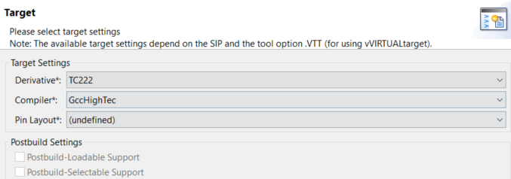
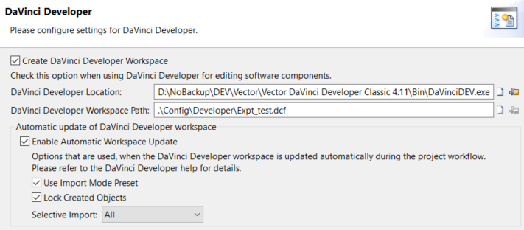
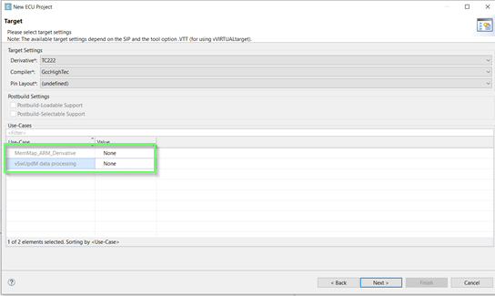
Steps for SIP Integration (Contd.)

Slide 10
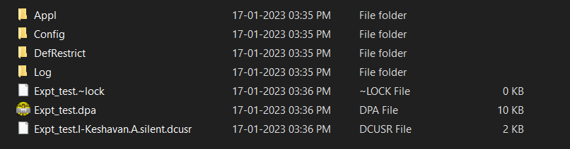
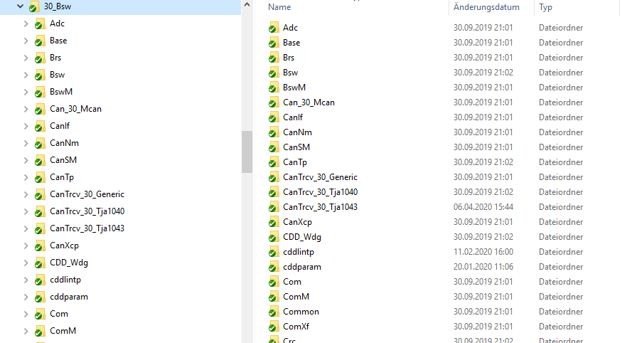
Steps Continued…….
Change the contents of 30_BSW folder
This is the generated folder structure

Slide 11
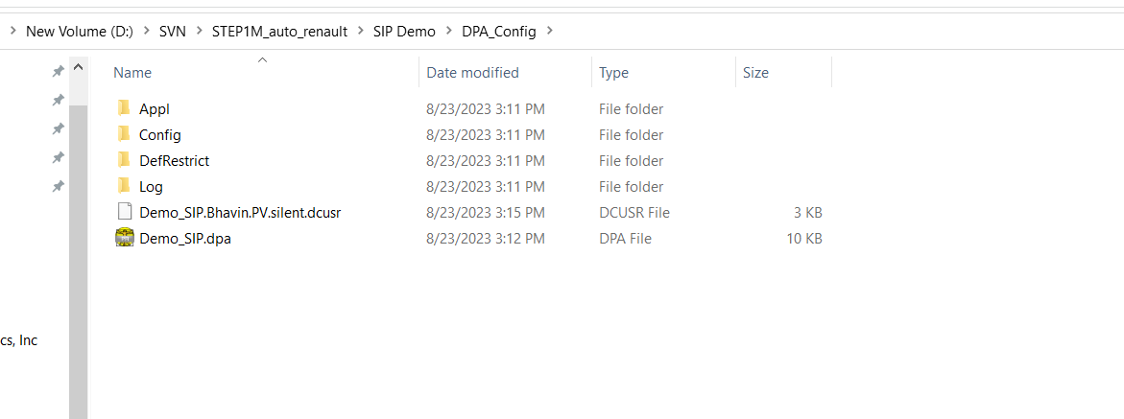
Steps Continued…….
This DPA_Config replaces the dpa folder already existed in the project or will become the part of 10_configuration .
Now a new demo project is created with same file structure
In 70 Tools ->60_ARToolChain, Add the SIP Files as how extracted
40_APPl is kept same (for sip update) or create it newly for new project
10_configuration remain same except for the dpa folder(60_dpa_config), here replace the dpa folder with the new dpa folder we created by doing the above step

Slide 12
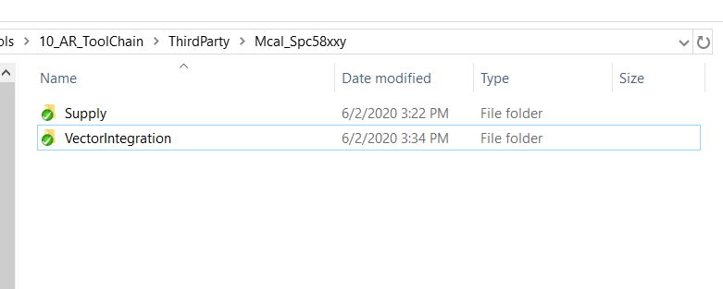
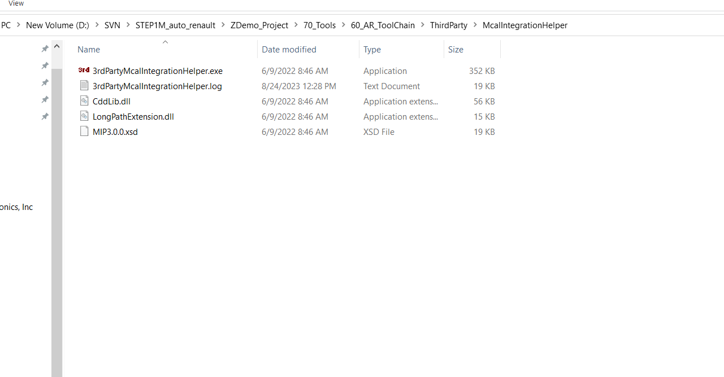
Add MCAL,restore supply folder
Add the supply folder which you can get from third party of the project 70 tools

Slide 13
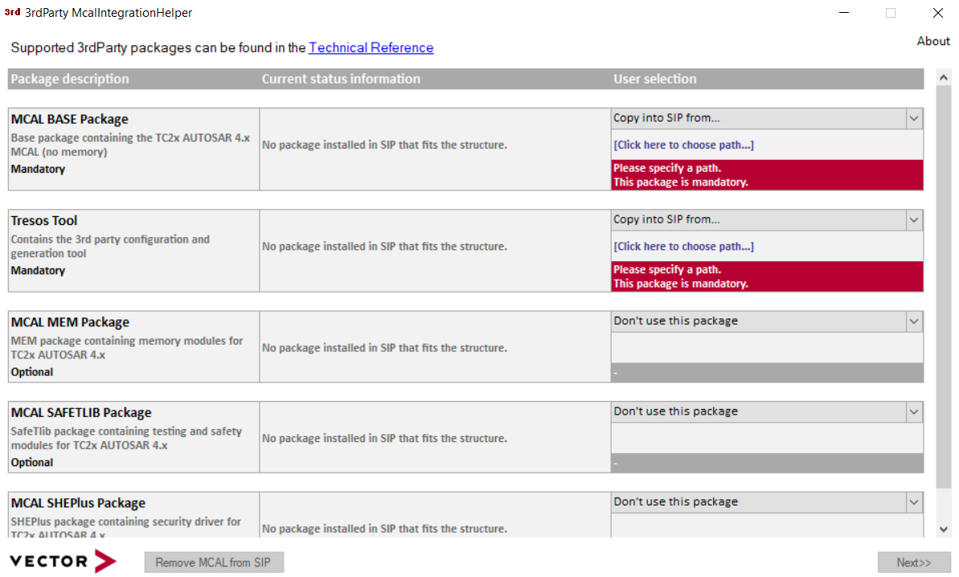
MCAL Integration
Specify the path to the current 3rd party packages like the MCAL and EB tresos package
and click on the “Next” button.
The tool will copy the 3rd party packages into the standard path in Vector MCAL Integration
Package. This is the folder Supply. After that it will proceed in integrating the 3rd party
packages into Vector MCAL Integration package. Within this process you might be asked to
select a derivative supported by the MCAL.
Any kind of problems will be reported in the log file 3rdPartyMcalIntegrationHelper.log which is next to the 3rdPartyMcalIntegrationHelper.exe. After the successful integration of the 3rd party packages, you can proceed with other tools to modify and generate your project such as the DaVinci Configurator 5 and external
generation tool, e.g. EB tresos.

Slide 14
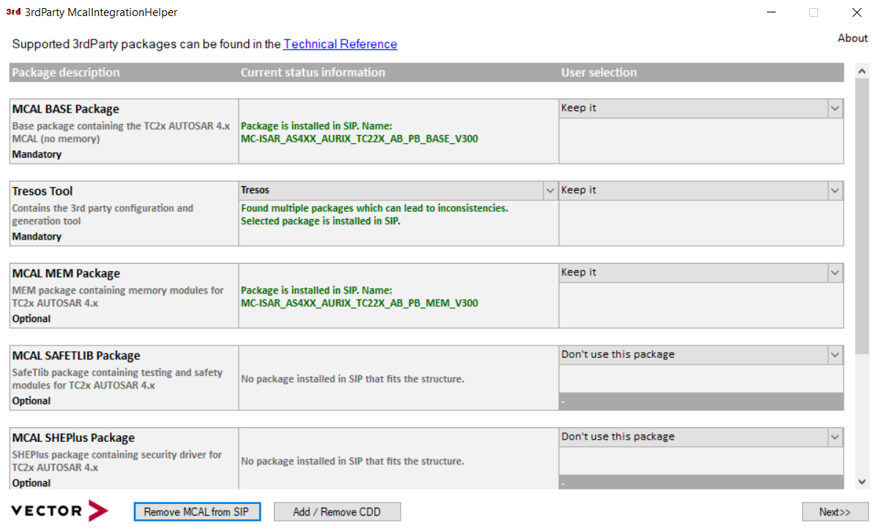
MCAL Integration (Contd)
Click the “Next” button: the tool will start the integration after you click the “Start” button.
Click the “Next” button when tool has finished: next step will offer all available derivatives:

Slide 15
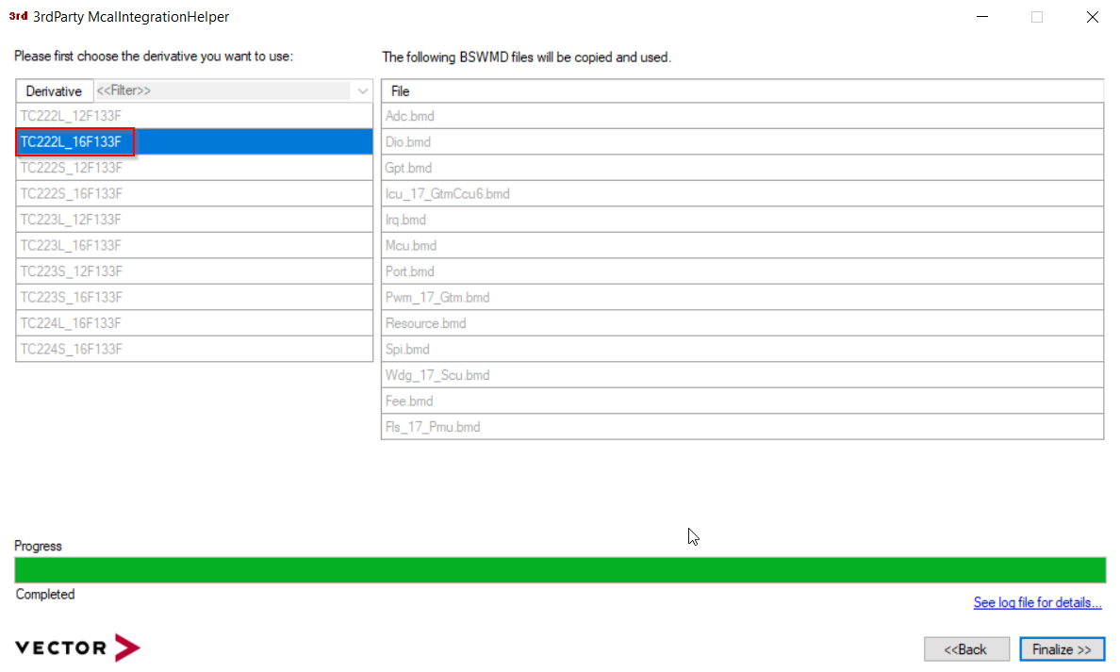
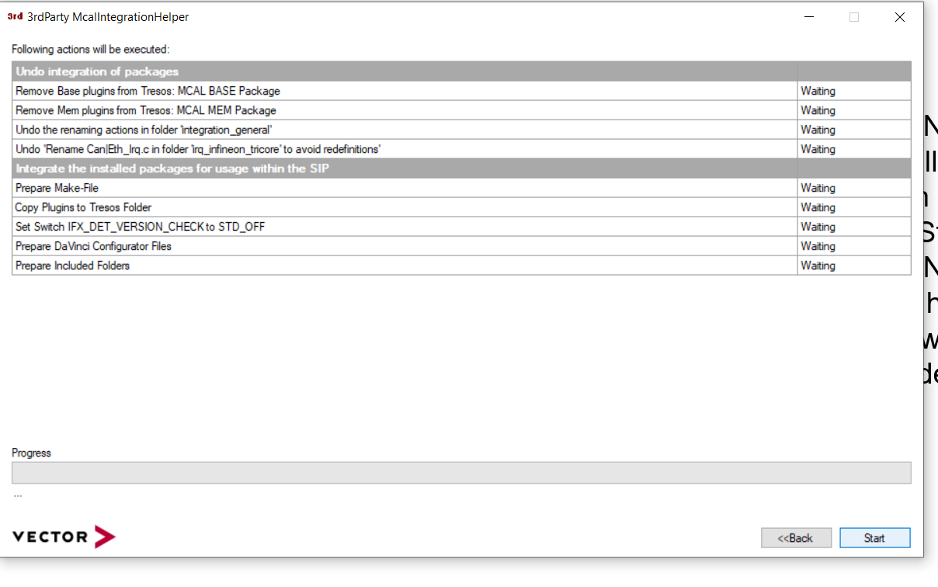
MCAL Integration (Contd)
Use this relative path For references
D:\SVN\STEP1M_auto_renault\SIP Demo\Doc\UserManuals

Slide 16
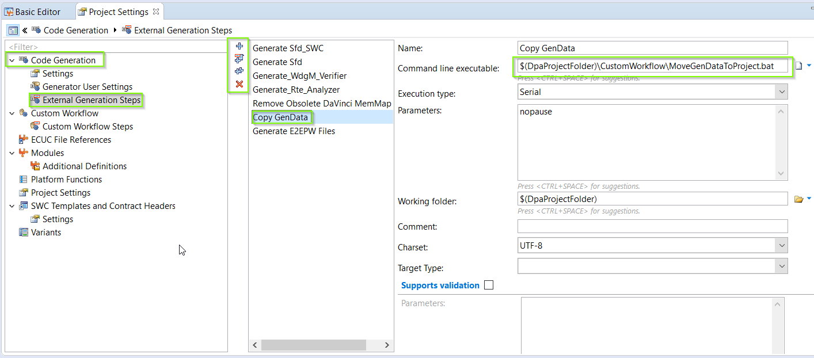
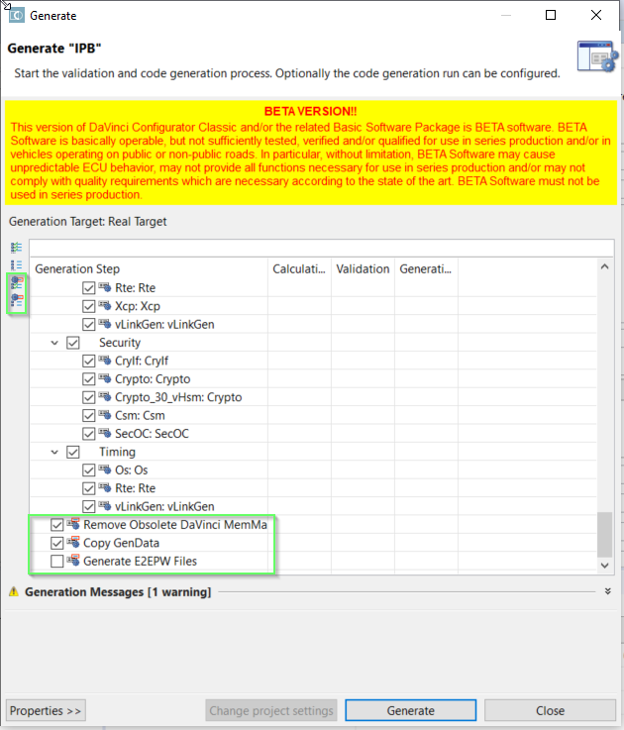
Scripting using Davinci
Go to the project settings in the Davinci Configurator, under the Code Generation section and add the scripting details under the external generation steps as shown in the picture. And these scripts can be found while code generation.

Slide 17
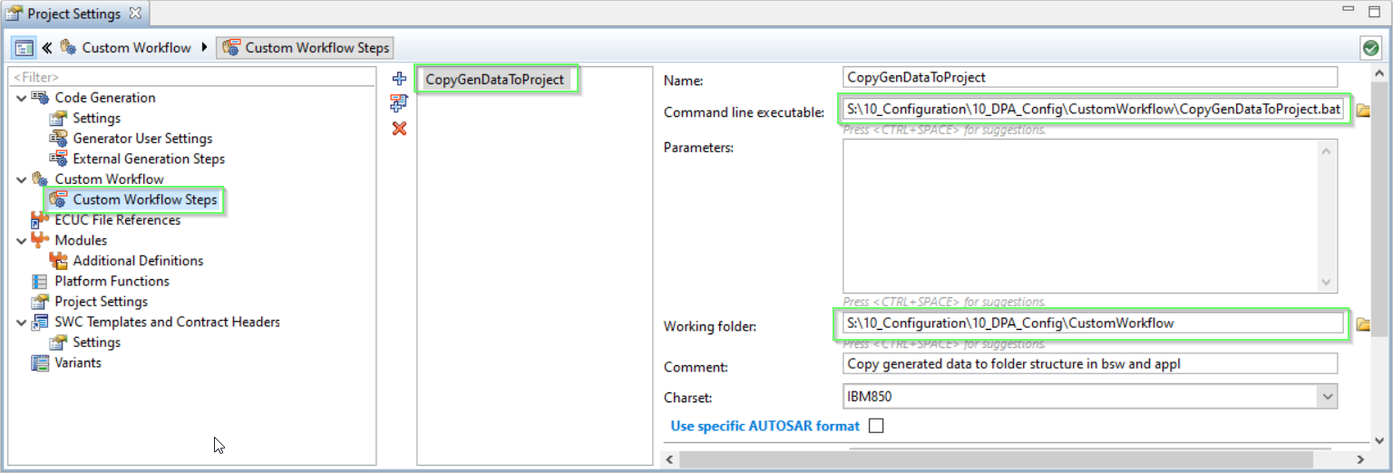
Scripting using Davinci (Contd)
Alternatively, the scripts can be directly added to the custom workflow steps under custom workflow found in the project settings, these scripts will run as soon as the code generation is completed. For ex:- CopyGenData, this script will copy the generated files directly to the 30_bsw and 40_appl under the config folder of each compoenents

Slide 18
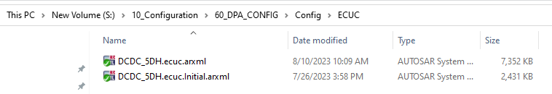
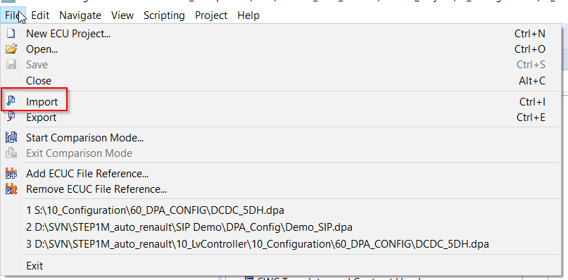
ECUC Config Import
S:\10_Configuration\60_DPA_CONFIG\Config\ECUC from this path import all the modules from the ECUC arxml files for SIP Update since this arxml will have all the configured data from the exisiting configuration of the project.

Slide 19
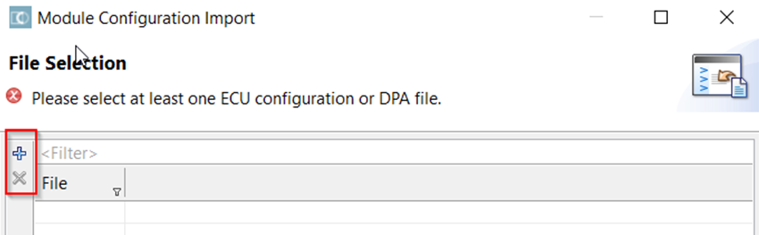
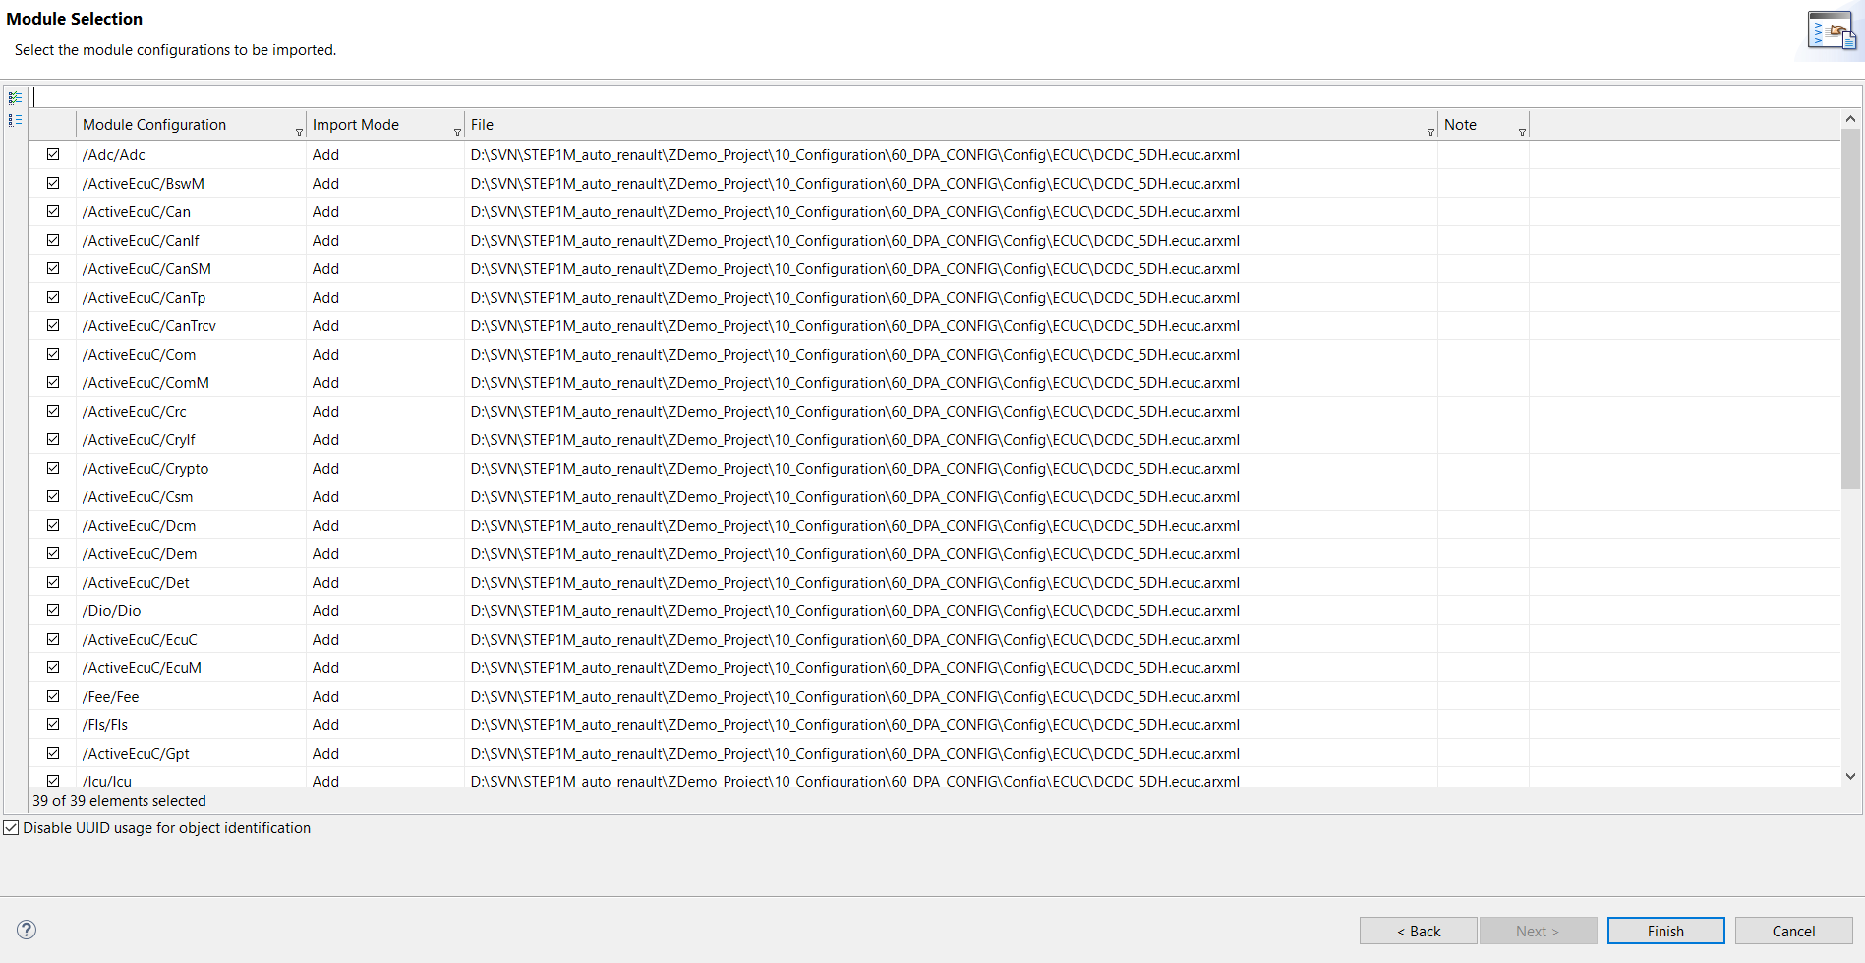
ECUC Config Import
Save and synchronize the dpa file
Add all the files and select all
Finish
Save the Cfg and Synchronize
Add the input files (project settings -> input files)
Add the cdd and dbc by comparing with the old dpa file
Now update the workflow and save
Finally solve all the errors

Slide 20
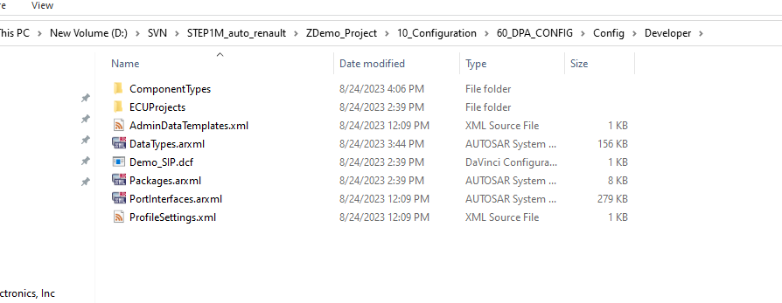
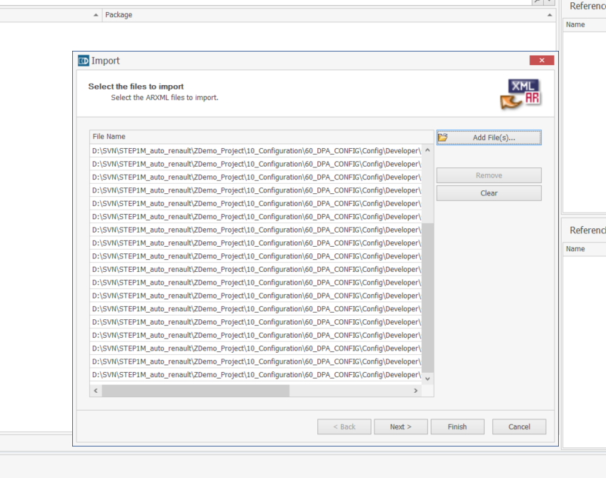
Open developer
Import all the arxml related to swc
Copy and paste component type folder from S:\10_Configuration\60_DPA_CONFIG\Config\Developer\ComponentTypes
To
D:\SVN\STEP1M_auto_renault\ZDemo_Project\10_Configuration\60_DPA_CONFIG\Config\Developer\ComponentTypes
Import the cdd and dbc files into (input files of project settings )
Compare with old dpa files for changes

Slide 21
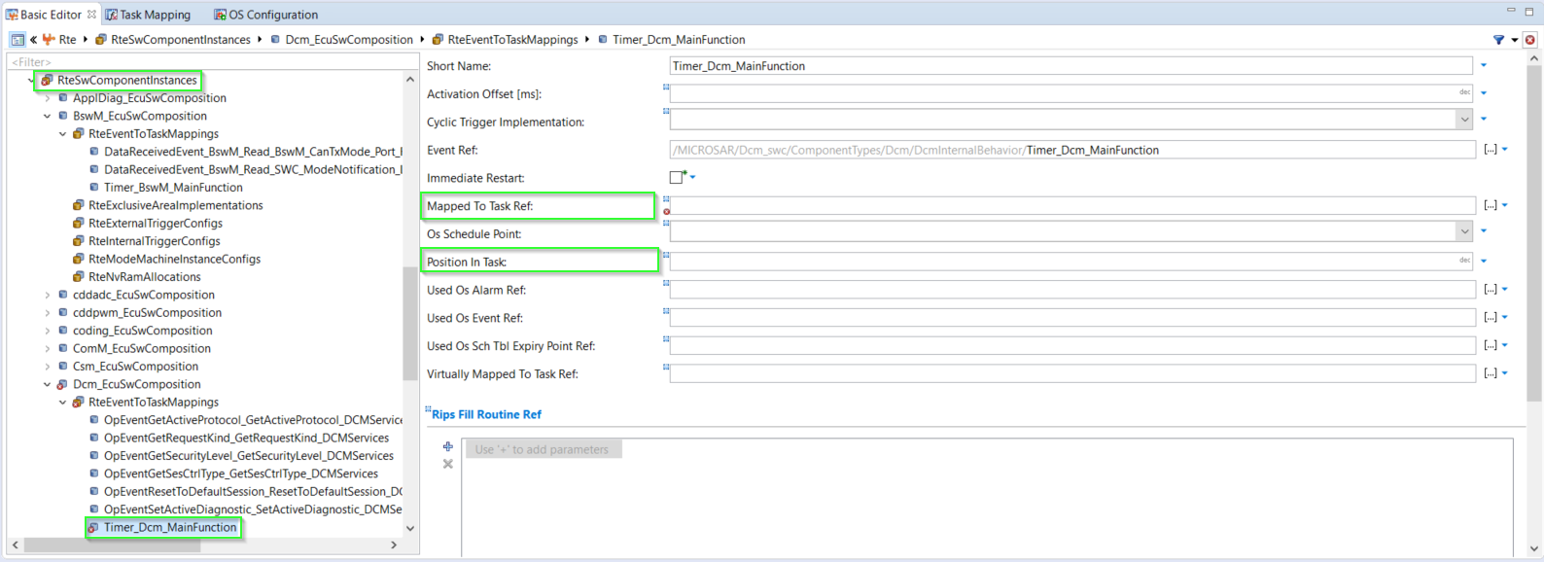
RTE, task mapping
Check for errors in the CFG and one such error that may arise is from RTE task mapping, make sure that all the application components and service components are mapped correctly with the right positions

Slide 22
Smarter. Greener. Together.

